Slide 1
The Impact of Artificial Intelligence in the Music Industry
Presented by:
Shreyas Achar M
Guide:
Ms. Rashmi Naveen

Slide 2

Table of Contents:
Introduction
AI in Music Production
Realistic Text-to-Speech
Voice Preservation and Revival
Challenges and Limitations
Future trends
Conclusion
References

Slide 3
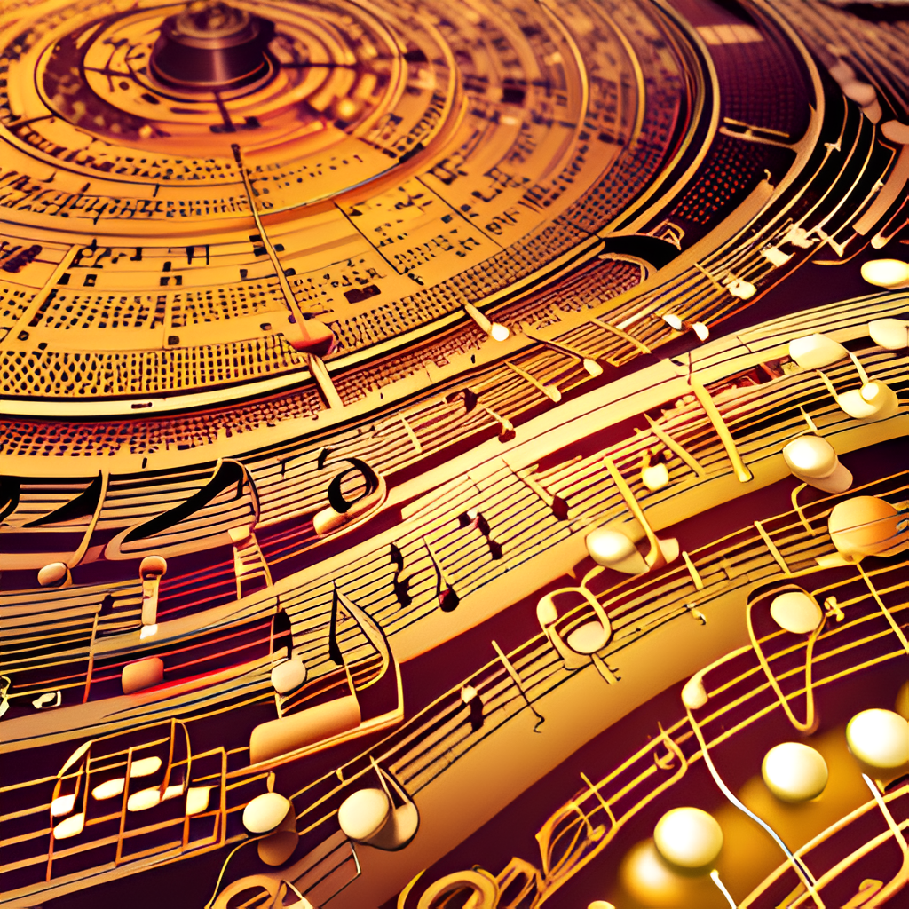
Introduction
Recent Surge in Computational Music Creation
Emergence of Music-Focused Generative Models
Unique Challenges in Music Generation
Controllability and Interactivity Concerns
Identifying challenges and future directions

Slide 4
AI in Music Production:
AI algorithms analyze existing music data to create melodies, chord progressions, and harmonies that align with a given style or mood
Mixing and mastering are critical stages in music production to achieve the desired audio quality. AI-powered tools can automate and improve these processes
AI tools can analyze the components of a music track, including vocals, instruments, and beats, and provide real-time editing capabilities
Musicians and producers can harness AI to create entirely new sonic textures and experiment with novel sounds

Slide 5

Realistic Text-to-Speech
Realistic TTS models are trained on extensive datasets of human singing, capturing the pitch, tone, and expression
These models use neural networks and deep learning techniques to mimic the human voice
Some Realistic TTS systems enable voice cloning, allowing artists to replicate their own voices or the voices of others
Realistic TTS technology supports multiple languages and accents, expanding its global appeal

Slide 6

Voice Preservation and Revival
The process often starts with the extensive recording of an artist's voice during their lifetime
Artificial intelligence, particularly deep learning models, is used to analyze and understand the unique characteristics of an artist's voice. This includes factors like pitch, tone, vibrato, and phrasing
AI can generate a highly accurate digital representation of the artist's voice, essentially creating a virtual vocal model
Voice preservation allows for the creation of new music, interviews, or spoken content featuring the artist's voice, even after their passing

Slide 7
Challenges and Limitations
AI-generated music may lack the depth of human creativity and emotional expression
AI lacks a deep understanding of emotions and context, making it challenging to create music that resonates emotionally with listeners
While AI can streamline processes, it may reduce opportunities for human musicians, composers, and audio engineers
Current copyright laws and frameworks may not fully address the unique issues arising from AI-created content

Slide 8
Future trends:
Musicians will collaborate with AI systems in real-time during live performances or studio sessions, blurring the lines between human and AI creativity
The creation of AI-generated virtual artists that can compose music, perform, and even interact with audiences
AI-powered music creation tools will continue to evolve, making it easier for musicians and producers to generate music, write lyrics, and experiment with new sounds
Music streaming platforms will increasingly use AI to provide highly personalized playlists and recommendations

Slide 9
Conclusion:
Artificial intelligence is a powerful tool that amplifies creativity and innovation in the music industry, offering musicians and professionals new avenues for music composition, production, and performance. As we embrace AI's potential, it's essential to strike a harmonious balance between human artistry and AI capabilities to ensure that music remains a timeless source of inspiration and connection for generations to come.

Slide 10
References:
[1] N. Zhang, J. Yan, and J.-P. Briot, "Artificial Intelligence Techniques for Pop Music Creation: a Real Music Production Perspective,“
[2]OpenAI, "GPT-3: Language Models," OpenAI. [Online]. Available: https://openai.com/research/language-models/gpt-3.

Slide 11
Thank you!

